Slide 1
Distributed and Loosely Coupled Parallel Molecular Simulations using the SAGA API
PI: Ronald Levy, co-PI: Emilio Gallicchio, Darrin York, Shantenu Jha
Consultants: Yaakoub El Khamra, Matt McKenzie
http://saga-project.org

Slide 2
Quick Outline
Objective
Context
Challenges
Solution: SAGA
Not really new
SAGA on TeraGrid
SAGA on XSEDE
Supporting Infrastructure
BigJob abstraction
DARE science gateway
Work plan: where we are now
References

Slide 3
Objective
Prepare the software infrastructure to conduct large scale distributed uncoupled (ensemble-like) and coupled replica exchange molecular dynamics simulations using SAGA with the IMPACT and AMBER molecular simulation programs.
Main Project: NSF CHE-1125332, NIH grant GM30580, addresses forefront biophysical issues concerning basic mechanisms of molecular recognition in biological systems

Slide 4
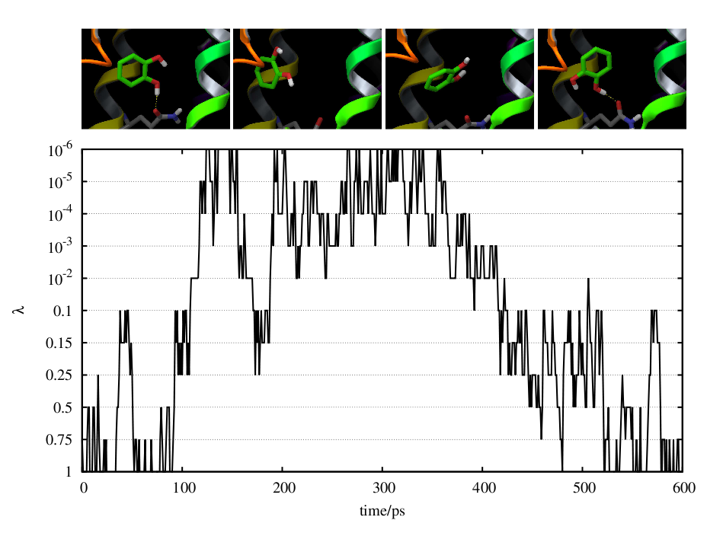
Protein-Ligand Binding Free Energy Calculations with IMPACT
Parallel Hamiltonian Replica Exchange Molecular Dynamics
λ: protein-ligand interaction progress parameter
λ-exchanges
λ = 0
...
Unbound
state
λ = 0.01
...
.
.
...
Bound
state
λ = 1
...
Achieve equilibrium between multiple binding modes.
Many l-replicas each using multiple cores.
Coordination and scheduling challenges.
Notes:
simulations made of many communicating threads (differing in the value of the "lambda" interaction parameter).
, they exchange lambda values according to a particular probabilistic prescription (not shown). The idea is that these exchanges enhance the exploration of molecular conformations.

Slide 5
Context: Not Just An Interesting Use Case
This is also an awarded CDI Type II Project: “Mapping Complex Biomolecular Reactions with Large Scale Replica Exchange Simulations on National Production Cyberinfrastructure “, CHE-1125332 ($1.65M for 4 years), PI: R. Levy
ECSS was requested to support the infrastructure
Integration, deployment
Many aspects in co-operation with SAGA team
Dedicated SAGA team member was assigned by SAGA Project

Slide 6
Challenges
Scientific Objective:
Perform Replica-Exchange on ~10K replicas, each replica large simulation
Infrastructure Challenges
Launch and monitor/manage 1k-10K individual or loosely coupled replicas
Long job duration: days to weeks (will have to checkpoint & restart replicas)
Pairwise asynchronous data exchange (no global synchronization)

Slide 7
Consultant Challenges
Consultants Challenges:
Software Integration and testing
high IO load, file clutter
Globus issues
Package version issues
…

Slide 8
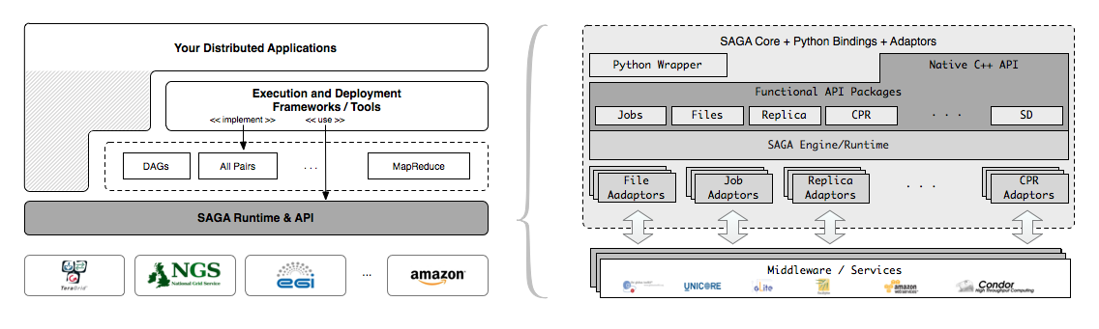
Simple Solution: SAGA
Simple, integrated, stable, uniform and community-standard
Simple and Stable: 80:20 restricted scope
Integrated: similar semantics & style across primary functional areas
Uniform: same interface for different distributed systems
The building blocks upon which to construct “consistent” higher-levels of functionality and abstractions
OGF-standard, “official” Access Layer/API of EGI, NSF-XSEDE

Slide 9
SAGA Is Production-Grade Software
Most (if not all) of the infrastructure is tried and true and deployed, but not at large scale
higher-level capabilities in development
Sanity checks, perpetual demos and performance checks are run continuously to find problems
Focusing on hardening and resolving issues when running at scale
Notes:
Refer to slide 7 Left part, for Higher-level capabilities --- DARE, DAG, MR, BigJob and other frameworks etc

Slide 10
SAGA on TeraGrid
SAGA deployed as a CSA on Ranger, Kraken , Lonestar and QueenBee
Advert service hosted by SAGA team
Replica exchange workflows, EnKF workflows and coupled simulation workflows using BigJob on TeraGrid (many papers; many users)
Basic science gateway framework

Slide 11
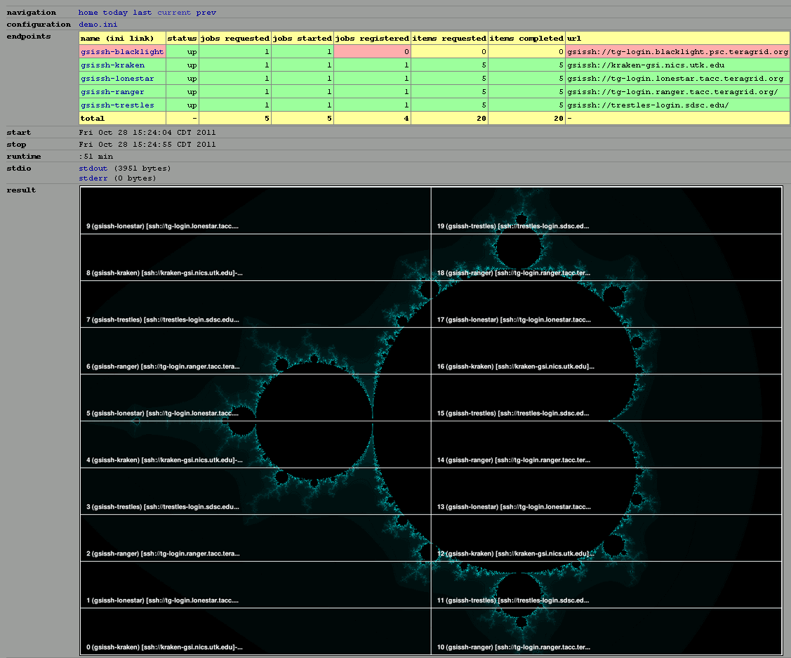
Perpetual SAGA Demo on XSEDE
Notes:
Mandlebrot simple demo Blacklight, kraken lonestar, ranger and trestles

Slide 12
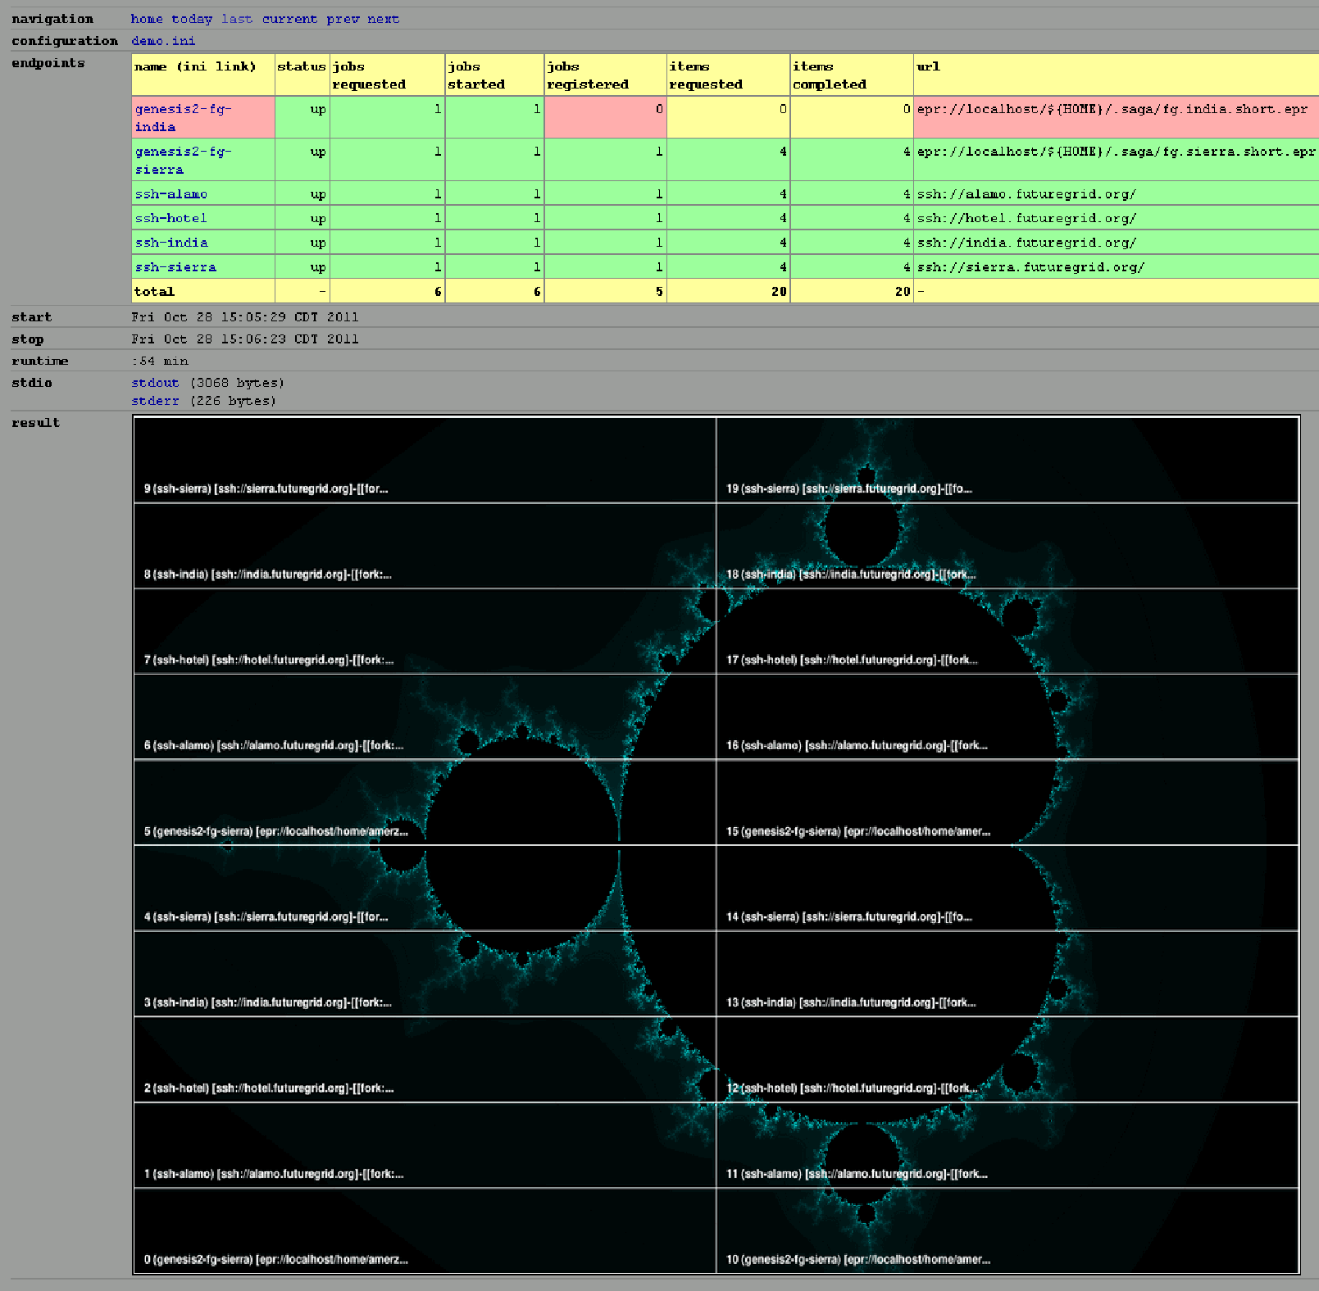
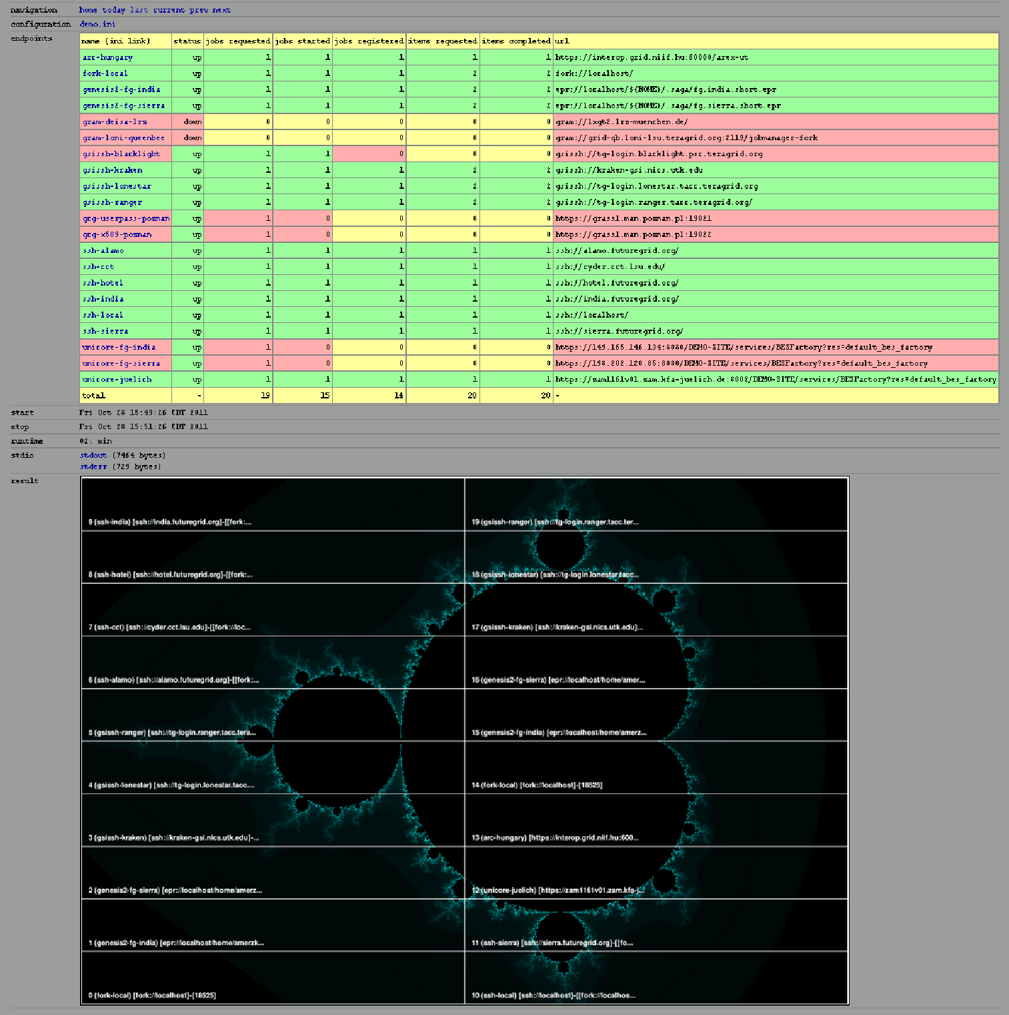
FutureGrid & OGF-GIN
Notes:
Same mandlebrot demo code, running on sierra, alamo, hotel, india and OGF machines

Slide 13
SAGA on XSEDE
Latest version (1.6.1) is available on Ranger, Kraken and Lonestar, will be deployed on Blacklight and Trestles as CSA
Automatic deployment and bootstrapping scripts available
Working on virtual images for advert service and gateway framework (hosted at Data Quarry)
Effort is to make the infrastructure: “system friendly, production ready and user accessible”

Slide 14
SAGA Supporting Infrastructure
Advert Service: central point of persistent distributed coordination (anything from allocation project names to file locations and job info). Now a VM on Data Quarry!
BigJob: a pilot job framework that acts as a container job for many smaller jobs (supports parallel and distributed jobs)
DARE: science gateway framework that supports BigJob jobs

Slide 15
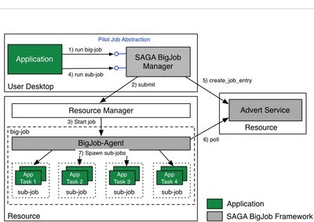
Aside: BigJob
SAGA BigJob comprises of three components
BigJob Manager that provides the pilot job abstraction and manages the orchestration and scheduling of BigJobs (which in turn allows the management of both bigjob objects and subjobs)
BigJob Agent that represents the pilot job and thus, the application-level resource manager running on the respective resource, and
Advert Service that is used for communication between the BigJob Manager and Agent.
BigJob supports MPI and distributed (multiple-machine) workflows
Notes:
What is different about SAGA-Pilot Jobs?
(i) This is all standards based file and jobs submission
(ii) By having SAGA deployed on XSEDE, BigJob is naturally supported, i.e., Integrated with XSEDE and thus easy to run/use

Slide 16
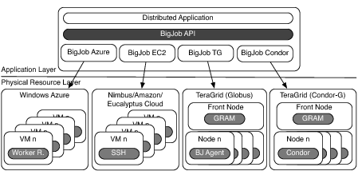
Distributed, High Throughput & High Performance
Notes:
Note that BigJob supports not only individual back-ends, but also concurrent usage of multiple back-ends
For example, BigJob is used on both Globus based Grid (XSEDE) and Condor (OSG) as part of the ExTENCI project
See P* Paper (submitted to IPDPS)..

Slide 17
BigJob Users (Limited Sampling)
Dr. Jong-Hyun Ham, Assistant Professor, Plant Pathology and Crop Physiology, LSU/AgCenter
Dr. Tom Keyes, Professor, Chemistry Department, Boston University
Dr. Erik Flemington, Professor, Cancer Medicine, Tulane University
Dr. Chris Gissendanner, Associate Professor, Department of Basic Pharmaceutical Sciences, College of Pharmacy, University of Louisiana at Monroe
Dr. Tuomo Rankinen, Human Genome Lab, Pennington Biomedical Research Center

Slide 18

Case Study SAGA BigJob: The computational studies of nucleosome positioning and stability
Main researchers:
Rajib Mukherjee, Hideki Fujioka, Abhinav Thota, Thomas Bishop and Shantenu Jha
Main supporters:
Yaakoub El Khamra (TACC) and Matt McKenzie (NICS)
Support from: LaSIGMA: Louisiana Alliance for Simulation-Guided Materials Applications
NSF award number #EPS-1003897 NIH: R01GM076356 to Bishop Molecular Dynamics Studies of Nucleosome Positioning and Receptor Binding TeraGrid/XSEDE Allocation MCB100111 to Bishop High Throughput High Performance MD Studies of the Nucleosome

Slide 19
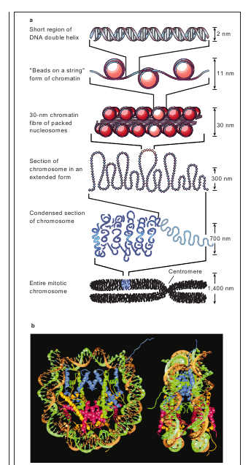
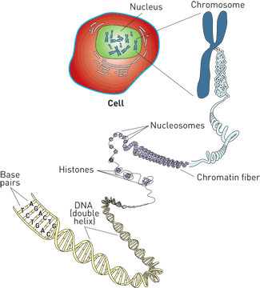
Molecular Biology 101
Under Wraps
C&E News July 17, 2006
http://pubs.acs.org/cen/coverstory/84/8429chromatin1.html
Felsenfeld&Groudine, Nature Jan 2003

Slide 20
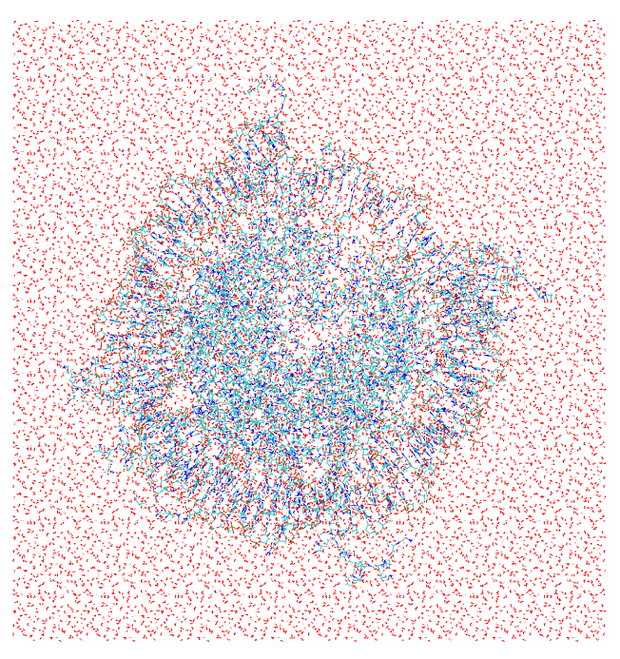
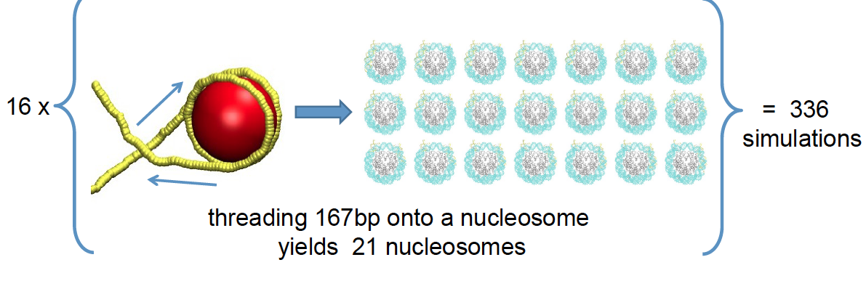
High Throughput of HPC Creation of nucleosome
Problem space is large
All atom, fully solvated nucleosome ~158,432 atoms
NAMD 2.7 with Amber force fields
16 nucleosomes x 21 different sequences of DNA = 336 simulations
Each requires 20 ns trajectory: broken into 1 ns lengths = 6,720 simulations
~25TB total output
4.3 MSU project
13.7nm x 14.5nm x 10.1nm

Slide 21
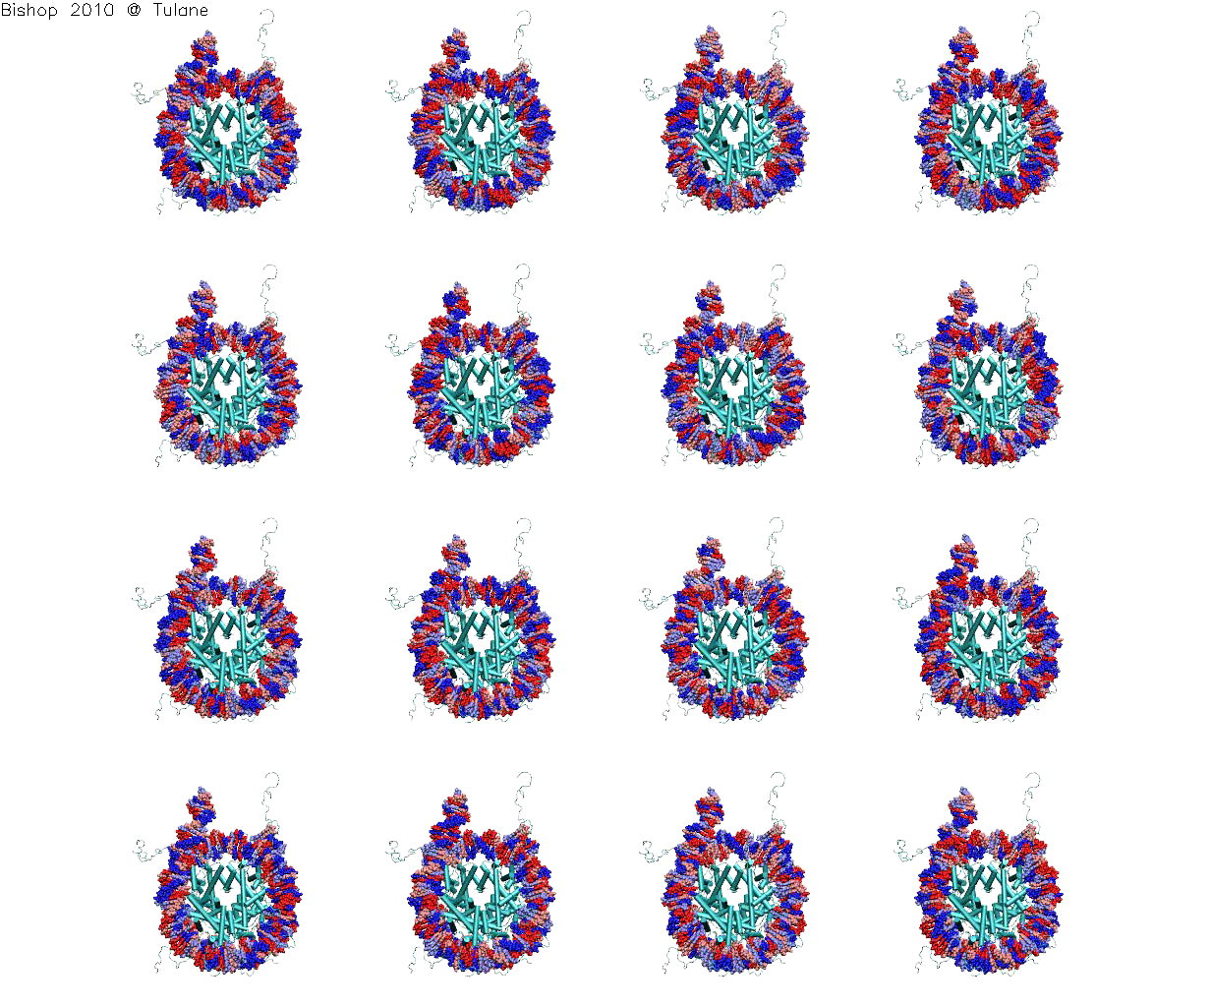
The 336 Starting positions
Notes:
Like a pulley

Slide 22
Simulation using BigJob in different machines
21, 42, 63 subjobs (1 ns simulations)
The simulation time seems to be same while the wait time varies considerably.
Running many MD simulations on Many supercomputers, Jha et al, under review,

Slide 23
Simulation using BigJob requesting 24,192 cores
9 BigJob runs were submitted to Kraken
Simulating 126 subjobs each with 192 cores
BigJob size = 126 X 192 = 24,192 cores
60% of this study utilized Kraken
Running many MD simulations on Many supercomputers, Jha et al, under review,

Slide 24
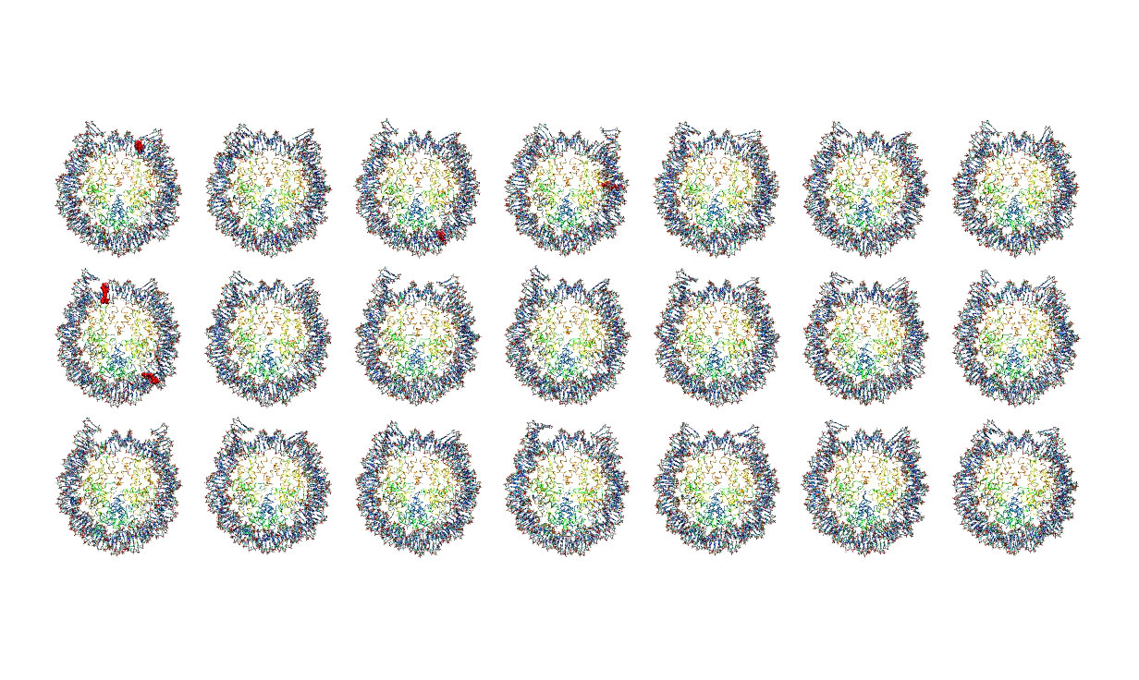
IF the protein completely controlled the deformations of the DNA
then we would expect the red flashes to always appear at the same locations
IF the DNA sequence determined the deformations (i.e. kinks occur at weak spots in the DNA)
then we would expect that the red flashes would simply shift around the nucleosome
Comparing the simulations in reading order:
Interplay of both the mechanical properties of DNA and the shape of the protein
Notes:
Results for 21 simulations/trajectories associated with one nucleosome
Flashing red spots indicate large deformations of DNA (kinks)- they appear & disappear as functions of time

Slide 25
DARE Science Gateway Framework
A science gateway to support (i) Ensemble MD Users, (ii) replica exchange users is attractive
By our count: ~200 Replica Exchange papers a year; even more ensemble MD papers
Build a gateway framework and an actual gateway (or two), make it available for the community
DARE-NGS: Next Generation Sequence data analysis (NIH supported)
DARE-HTHP: for executing High-Performance Parallel codes such as NAMD and AMBER in high-throughput mode across multiple distributed resources concurrently

Slide 26
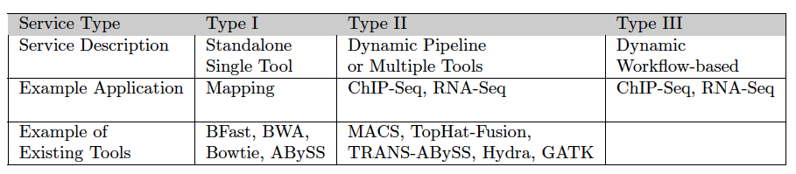
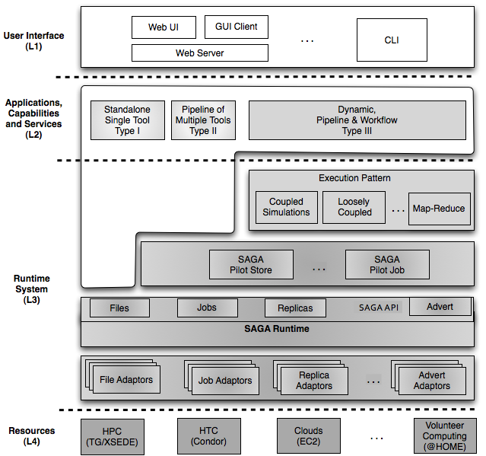
DARE Infrastructure
Secret sauce: L1 and L2 layers
Depending on the application type, use a single tool, a pipeline or a complex workflow
Notes:
The PI's of the SAGA project is both distributed computing and NGS analytics. Therefore in appreciation of the computational characteristics and challenges the dare based gateway is being developed. We are doing both research and tool development and well positioned in xsede we are well positioned to provide this as a gateway to the XSEDE community.

Slide 27
Work plan: where we are now
Deploy SAGA infrastructure on XSEDE resources (Finished on Ranger, Kraken and Lonestar) + Module support
Deploy a central DB for SAGA on XSEDE resources (Finished: on an IU Data Quarry VM)
Deploy the BigJob pilot job framework on XSEDE resources (Finished on Ranger)
Develop BigJob based scripts to launch NAMD and IMPACT jobs (Finished on Ranger)
Deploy the science gateway framework on VM (Done)
Run and test scale-out

Slide 28
References
SAGA website: http://www.saga-project.org/
BigJob website: http://faust.cct.lsu.edu/trac/bigjob/
DARE Gateway: http://dare.cct.lsu.edu/

